Slide 1
Dictionary

Slide 2
Table of Contents
Introduction
motivation
Problem Statement
Screenshots
Implementation Details

Slide 3
Introduction
Implementation of a dictionary where the dictionary words along with their meanings are saved in a file e.g. dictionary file. The application reads the file when started and save the words and their meanings in a data structure (in our case binary trees). The user can search any word and the application will give the meanings of that word. If the word is not found, the application gives a message and offers the user to enter this word and its meaning into the dictionary. When user gives a word and its meaning to be added in the dictionary, the application saves the word and its meaning in the dictionary file.

Slide 4
Motivation
The idea was simple we wanted to gain a better understanding of data structures than before. And we have gained quite some experience while using the data structures in the project. This has helped us quite a lot.

Slide 5
PROBLEM STATEMENT
First we tried implementing the dictionary with using binary trees that worked completely fine. But then we started using hash maps for this purpose and we faced lots of problems as in insertion of the springs and re-arrangement of words added in the dictionary. It was resulting in lots of errors so for our own convenience in the project submission we only included the part of binary tress.
Another was also faced while reading and writing data from the file to the trees and while closing back to the trees.

Slide 6
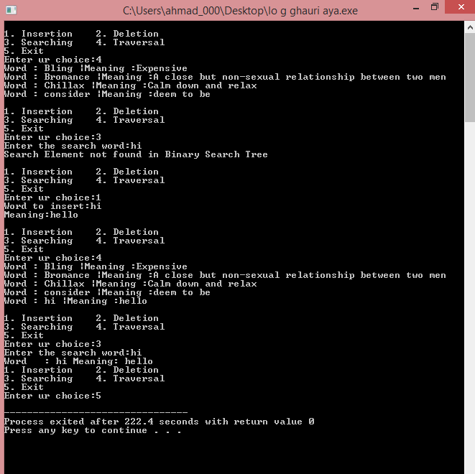
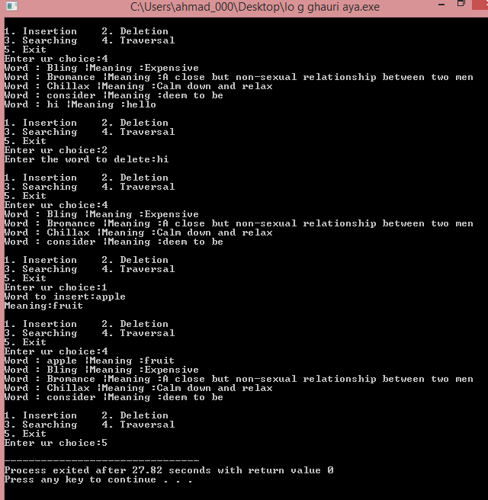

Slide 7
Implementation details
Software/Tools used:
Dev C++/ Sublime Text
This software was used to program the whole project.

Slide 8
Thank you

